Slide 1
Guidelines for selection process

Slide 2
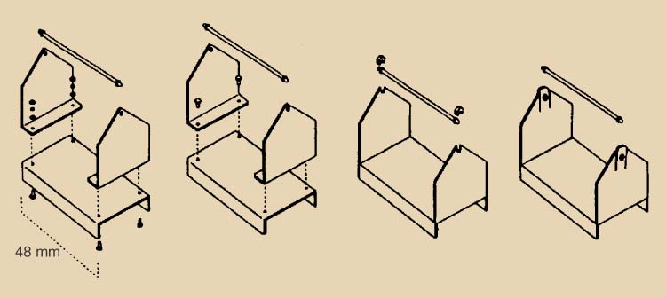
Factors Impacting Product Design
Need to Design for Manufacturing – DFM
Series of guidelines to follow in order to produce a product easily and profitably
Simplification - Minimize parts
Standardization
Design parts for multiply applications
Use modular design
Simplify operations

Slide 3
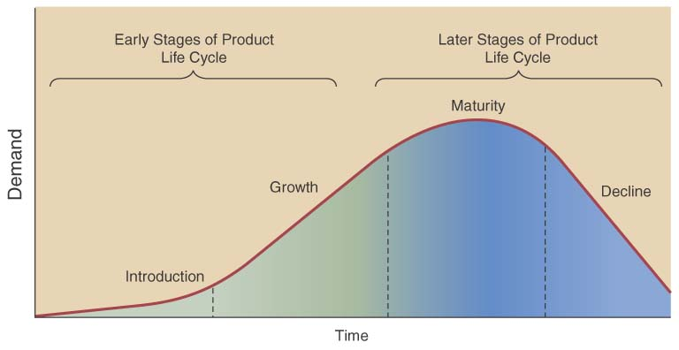
Factor In Product Life Cycle
Product life cycle – series of changing product demand
Consider product
life cycle stages
Introduction
Growth
Maturity
Decline
Facility & process investment depends on life cycle

Slide 4
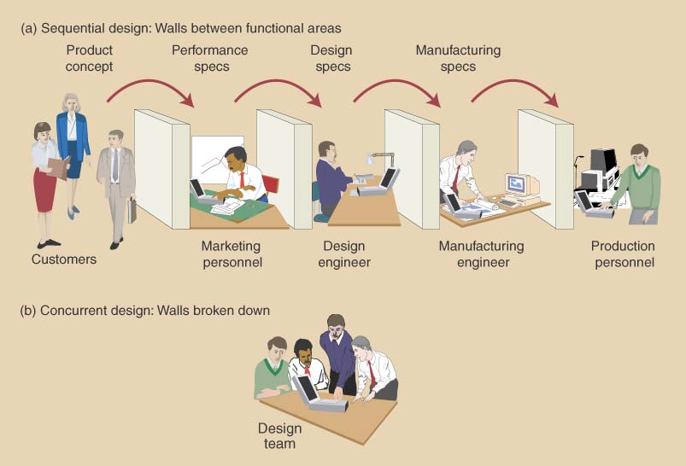
Concurrent Engineering
Old “over-the –wall” sequential design process should not be used
Each function did its work and passed it to the next function
Replace with a Concurrent Engineering process
All functions form a design team working together to develop specifications, involve customers early, solve potential problems, reduce costs, & shorten time to market

Slide 5
Process Selection
Product design considerations must include the process
Two broad process classifications include
Intermittent operations – produce a variety of products in lower volumes
Repetitive operations – produce one or a few standardized products in high volume

Slide 6
Process Selection
Process selection is based on five considerations
Type of process; range from intermittent to continuous
Degree of vertical integration
Flexibility of resources
Mix between capital & human resources
Degree of customer contact

Slide 7
Process Selection
Process types can be:
Project process – make a one-at-a-time product exactly to customer specifications
Batch process – small quantities of product in groups or batches based on customer orders or specifications
Line process – large quantities of a standard product
Continuous process – very high volumes of a fully standard product
Process types exist on a continuum

Slide 8
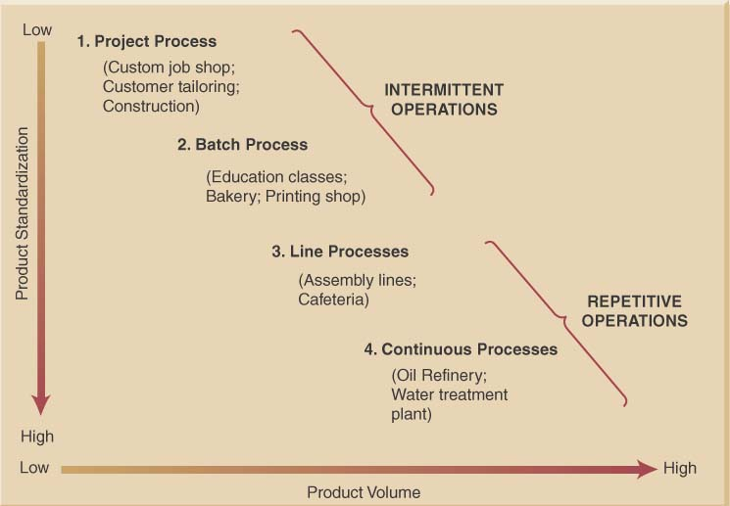
Underlying Process Relationship Between Volume and Standardization Continuum

Slide 9
Differences between Intermittent and Continuous Operations

Slide 10
Designing Processes
Process design tools include
Process flow analysis
Process flowchart
Design considerations include
Make-to-stock strategy
Assemble-to-order strategy
Make-to-order strategy

Slide 11
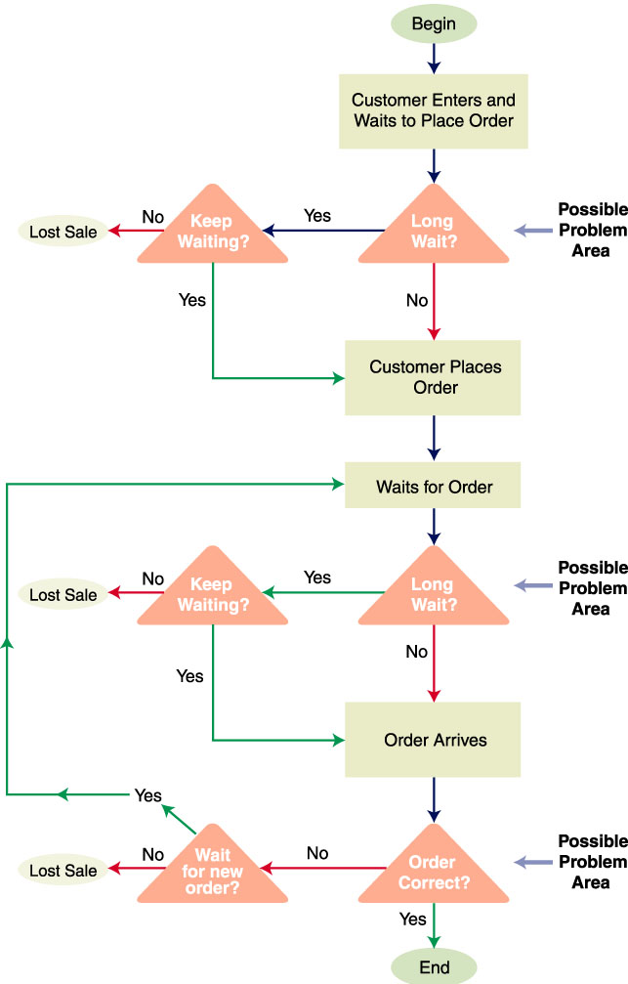
Process Design Tools
Process flow analysis is a tool used to analyze and document the sequence of steps within a total process. Usually first step in Process Reengineering.
Process Re-engineering is a structured approach used when major business changes are required as a result of:
Major new products
Quality improvement needed
Better competitors
Inadequate performance

Slide 12
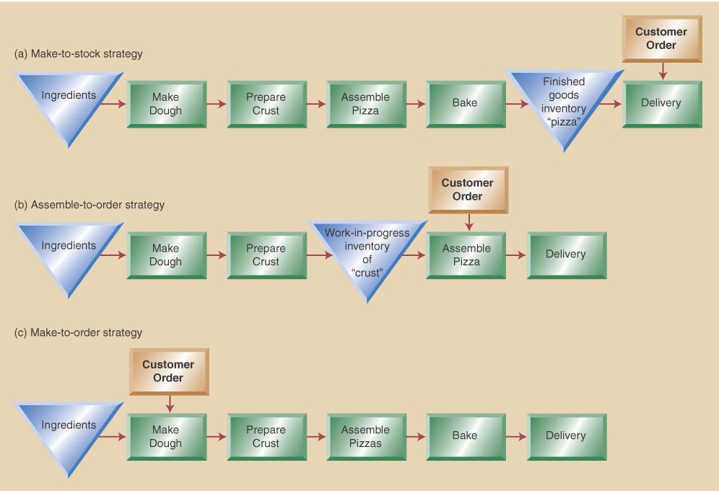
Facility Layout and Process Choice

Slide 13
Process Performance Metrics
Determining if a process is functioning properly is required
Determination requires measuring performance
Process performance metrics – measurement of different process characteristics that tell us how a process is performing

Slide 14
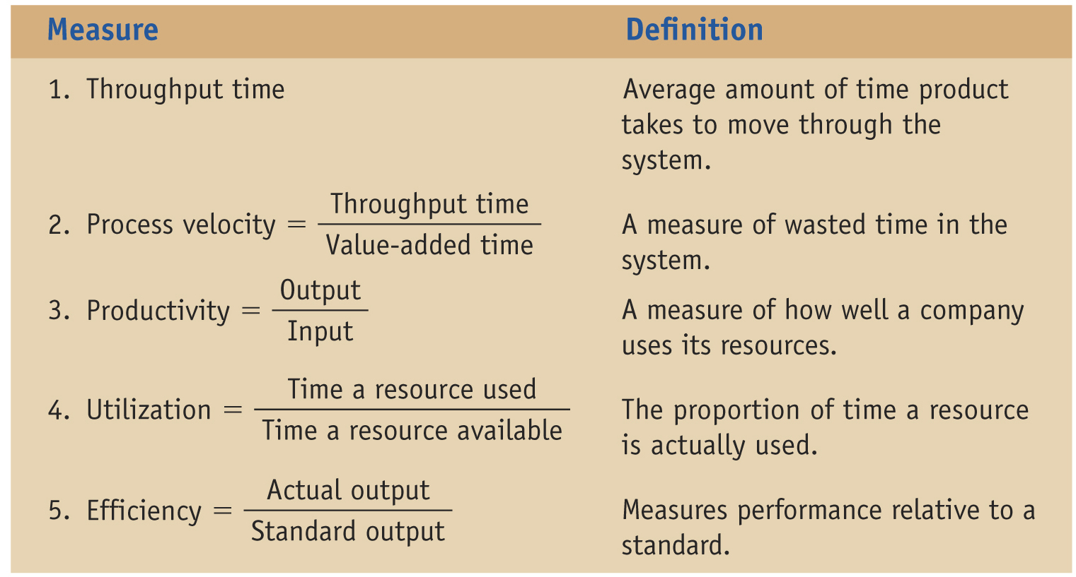
Process Performance Metrics

Slide 15
Linking Product Design & Process Selection
Product design and process selection directly linked
Type of product selected defines type of operation required
Type of operation available defines broader organizational aspects such as
Equipment required
Facility arrangement
Organizational structure

Slide 16
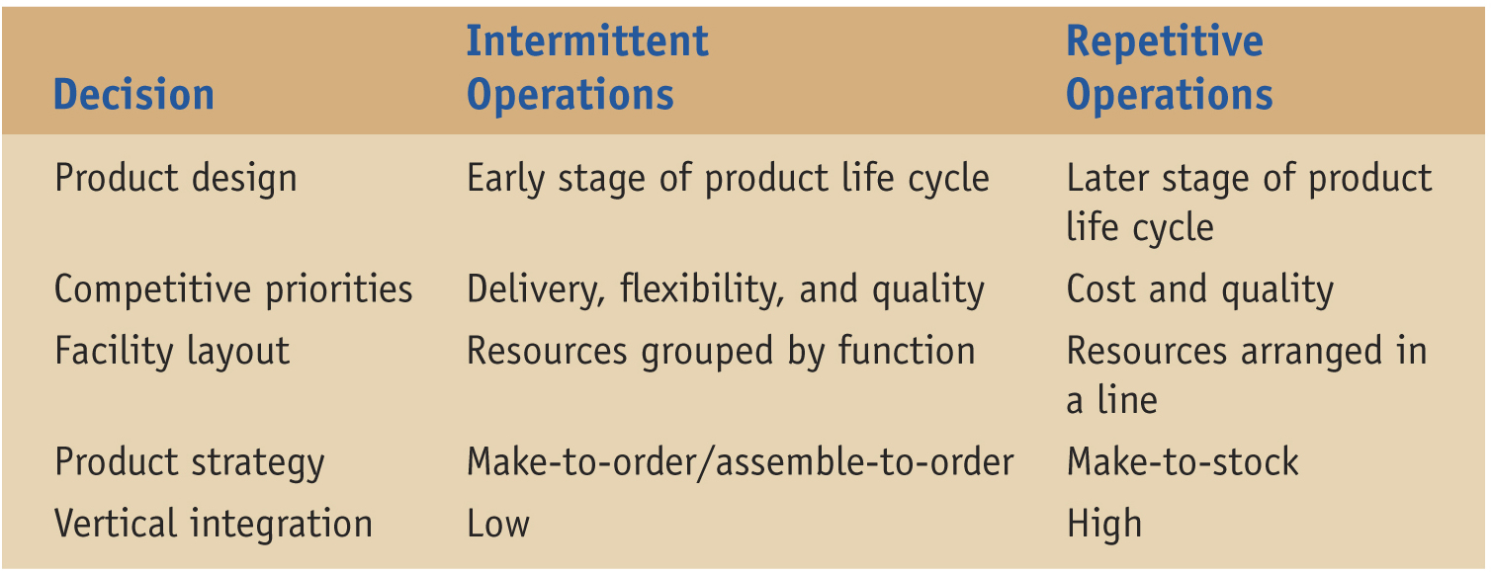
Linking Design & Process Selection
Organizational Decisions appropriate for different types of operations

Slide 17
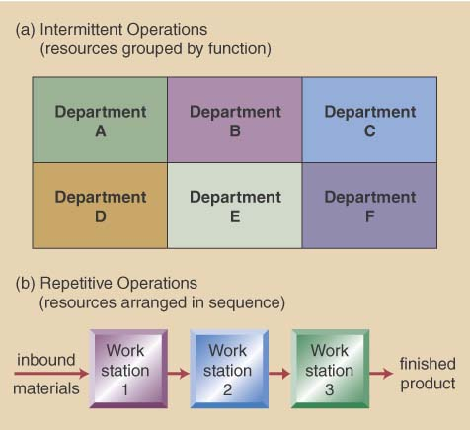
Intermittent VS. Repetitive Layouts

Slide 18
Product and Service Strategy
Type of operation is directly related to product and service strategy
Three basic strategies include
Make-to-stock; in anticipation of demand
Assemble-to-order; built from standard components on order
Make-to-order; produce to customer specification at time of order

Slide 19
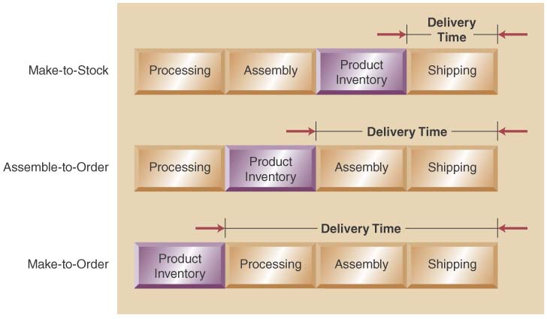
Product and Service Strategy Options

Slide 20
Process Decisions-Vertical Integration & Make or Buy
Vertical integration refers to the degree a firm chooses to do processes itself- raw material to sales
Backward Integration means moving closer to primary operations
Forward Integration means moving closer to customers
A firm’s Make-or-Buy choices should be based on the following considerations:
Strategic impact
Available capacity
Expertise
Quality considerations
Speed
Cost (fixed cost + variable cost)make = Cost (fixed cost + Variable cost)buy
Business are trending toward less backward integration, more outsourcing

Slide 21
Manufacturing Technology Decisions
Simplify first then apply appropriate technology
Information Technology: ERP, GPS, RFID
Automation
Automated Material Handling:
Automated guided vehicles (AGV)
Automated storage & retrieval systems (AS/RS)
Flexible Manufacturing Systems (FMS)
Robotics & Numerically-Controlled (NC) equipment

Slide 22
E-manufacturing
Web-based environment creates numerous business opportunities to include;
Product design collaboration
Process design collaboration
Computer-aided design – uses computer graphics to design new products
Computer-integrated manufacturing – integration of product design, process planning, and manufacturing using an integrated computer system

Slide 23
How Are Services Different from Manufacturing
Services are different from manufacturing as they;
Produce intangible products
Involve a high degree of customer contact
Type of service is classified according to degree of customer contact

Slide 24
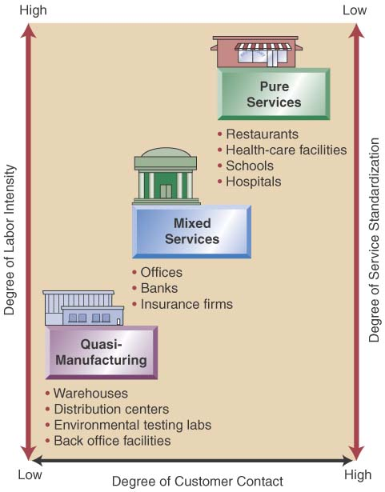
Designing Services
Service Characteristics
Pure services
Quasi-Manufacturing
Mixed services
Service Package
The physical goods
The sensual benefits
The psychological benefits
Differing designs
Substitute technology for people
Get customer involved
High customer attention

Slide 25
Product Design and Process Selection Across the Organization
Strategic and financial of product design and process selection mandates operations work closely across the organization
Marketing is impacted by product that is produced
Finance is integral to the product design and process selection issues due to frequent large financial outlays

Slide 26
Product Design and Process Selection Across the Organization - continued
Strategic and financial of product design and process selection mandates operations work closely across the organization
Information services has to be developed to match the needs of the production process
Human resources provides important input to the process selection decisions for staffing needs

Slide 27
Product Design and Process Selection Across the Organization - continued
Product design is the process of deciding on the unique characteristics and features of a company’s product Process selection is the development of the process necessary to produce the product being designed.
Steps in product include idea generation, product screening, preliminary design and testing, and final design
Break-even analysis is a tool used to compute the amount of goods that have to be sold just to cover costs.
Production processes can be divided into two broad categories: intermittent and repetitive operation project to batch to line to continuous

Slide 28
Product Design and Process Selection Across the Organization - continued
Product design and process selection decisions are linked
Process flow charts is used for viewing the flow of the processes involved in producing the
Different types of technologies can significantly enhance product and process design. These include automation, automated material handling devices, CAD, NC, FMS, and CIM
Designing services have more complexities than manufacturing, because service produce an intangible product and typically have a high degree of customer contact.

Slide 29
Solutions

Slide 30
Solutions

Slide 31
Alternative technologies

Slide 32
Challenges of selection
Strict Industry Regulations
Product Inconsistencies
Wasted Materials
Environmental Consciousness
Lack of Supply Chain Transparency

Slide 33
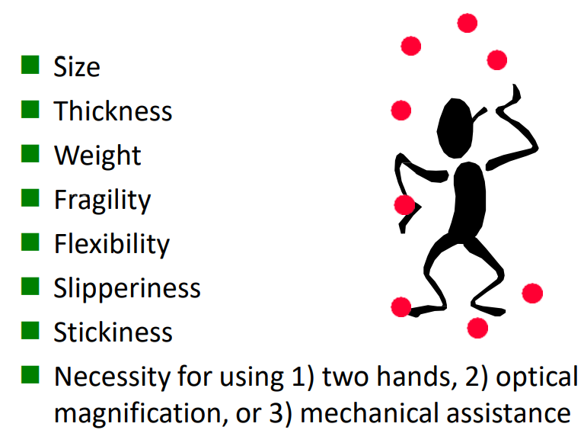
Challenges of selection

Slide 34
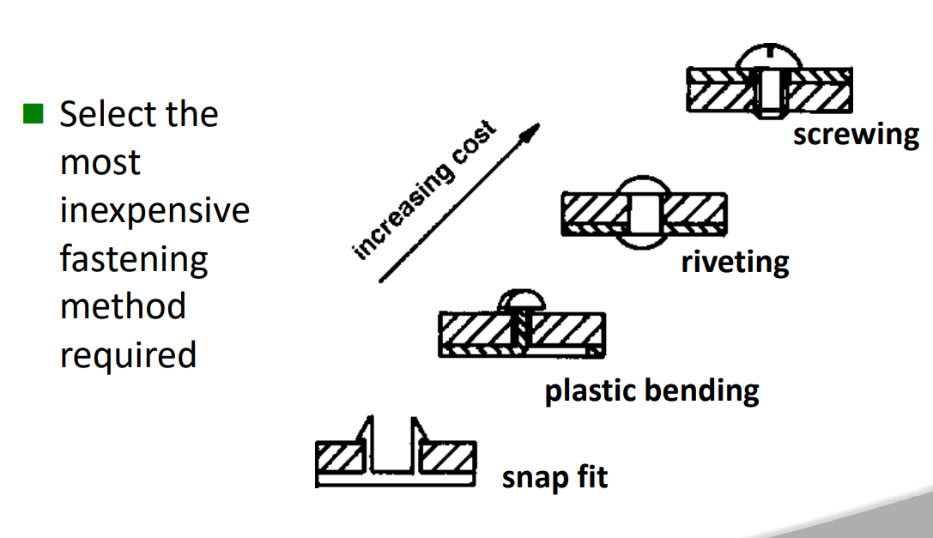
Challenges of selection

Slide 35
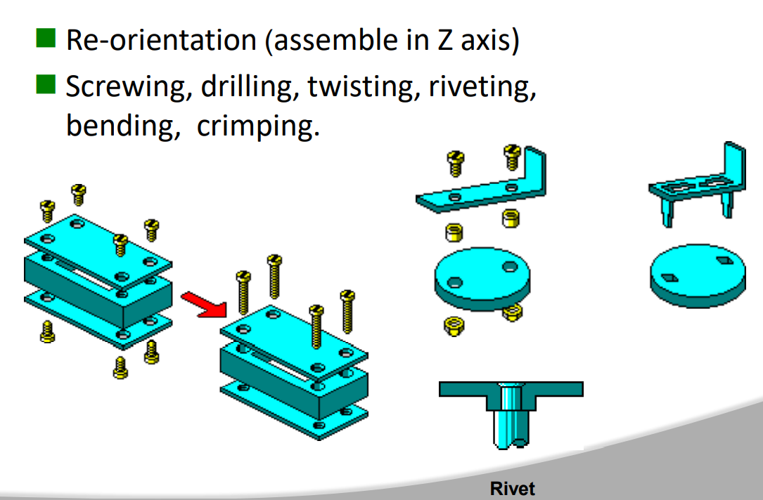
Challenges of selection

Slide 36
Production Planning

Slide 37
Aggregate planning
Definition
Choosing production rates, work force levels, and inventory levels
Horizon
6-18 months into future
Prerequisites
Forecasting
Company policies on
Max./min. inventories
Hiring/firing
Overtime

Slide 38
Policy considerations in aggregate planning
Flexibility
Are work force and inventories maintained at a level sufficient to meet unexpected demand?
Work force stability
Improves quality, productivity, union relations
Production rate stability
Makes materials planning easier, reduces uncertainty in physical distribution
APP.xls

Slide 39
Policy considerations in aggregate planning (cont.)
Production capacity
Will overtime reduce quality? When will physical capacity (space, machinery, equipment) become inadequate?
Customer service
Have lead time and stock availability goals been met?

Slide 40
Aggregate planning in services
Definition
Balancing service capacity with demand
Tactics
Change operating hours
Change staffing
Nbr. of workers
Full vs. part-time
Modify type of service
Influence demand
Advertising
Pricing
Build more service outlets

Slide 41
Aggregate planning in services (cont.)
Evaluation
Waiting time
Throughput
Service time
Nbr. of lost customers

